Slide 1
G
-
Customer Segmentation

Slide 2
Group Members
D1161 - Samet
D1366 - Necip
D1404 - Selin
D1649 - Fatih
Group Mentor
Mary

Slide 3
Contents
01
Data Cleaning & EDA
02
RFM Analysis
03
K-Means Clustering
04
Cohort & Conduct Cohort Analysis

Slide 4

Tools
JUPYTER NOTEBOOK
COLAB
PYTHON
API
Scrapy
Selenium

Slide 5
Customer Segmentation
Welcome to "RFM Customer Segmentation & Cohort Analysis Project".
This is a project which we will learn what is RFM? And how to apply RFM Analysis and Customer Segmentation using K-Means Clustering. Also we will improve our Data Cleaning, Data Visualization and Exploratory Data Analysis capabilities. On the other hand we will create Cohort and Conduct Cohort Analysis.

Slide 6
Customer Segmentation
General Information
This is a transnational data set which contains all the transactions occurring between 01/12/2010 and 09/12/2011 for a UK-based and registered non-store online retail. The company mainly sells unique all-occasion gifts. Many customers of the company are wholesalers.
Feature Information:
InvoiceNo: Invoice number. Nominal, a 6-digit integral number uniquely assigned to each transaction. If this code starts with letter 'c', it indicates a cancellation.
StockCode: Product (item) code. Nominal, a 5-digit integral number uniquely assigned to each distinct product.
Description: Product (item) name. Nominal.
Quantity: The quantities of each product (item) per transaction. Numeric.
InvoiceDate: Invoice Date and time. Numeric, the day and time when each transaction was generated.
UnitPrice: Unit price. Numeric, Product price per unit in sterling.
CustomerID: Customer number. Nominal, a 5-digit integral number uniquely assigned to each customer.
Country: Country name. Nominal, the name of the country where each customer resides.

Slide 7
STEPS
Step 3
Step 5
Step 1
Applying K-Means Clustering
Final Presentation
Data Cleaning & Exploratory Data Analysis
Step 2
Step 4
RFM Analysis
Customer Segmentation
Create Cohort and Conduct Cohort Analysis

Slide 8
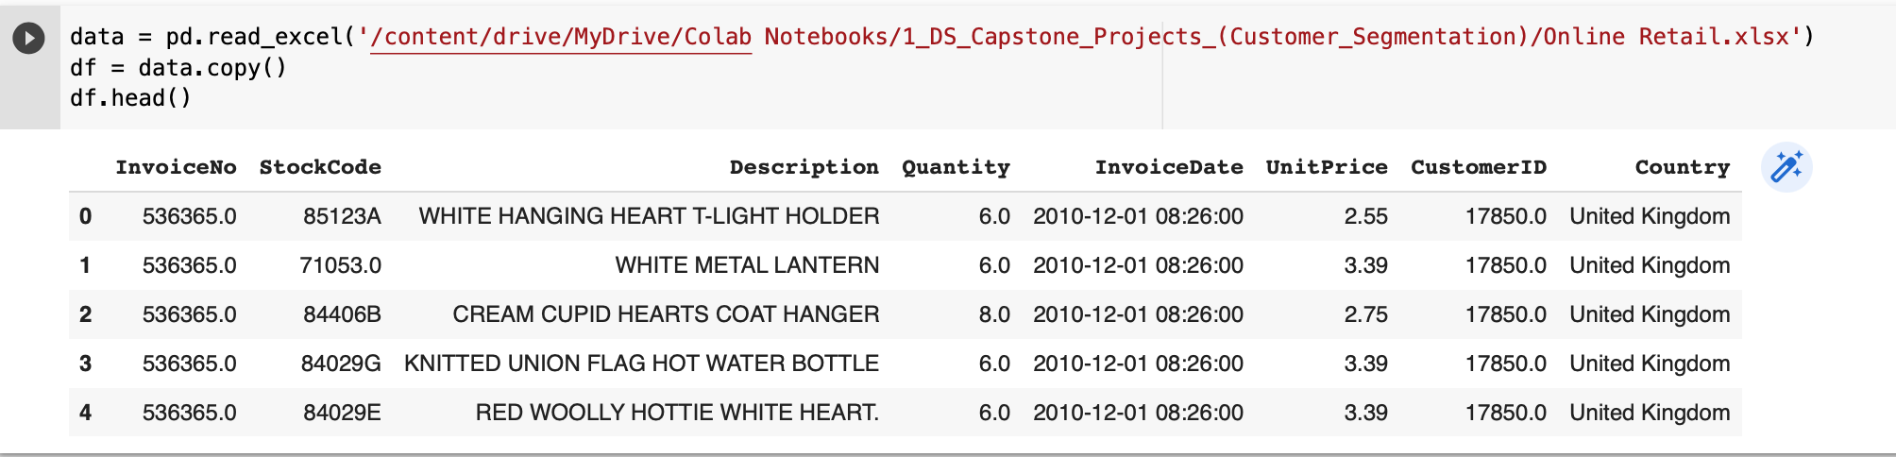
Quick Look at Our Dataset
STEP 1

Slide 9
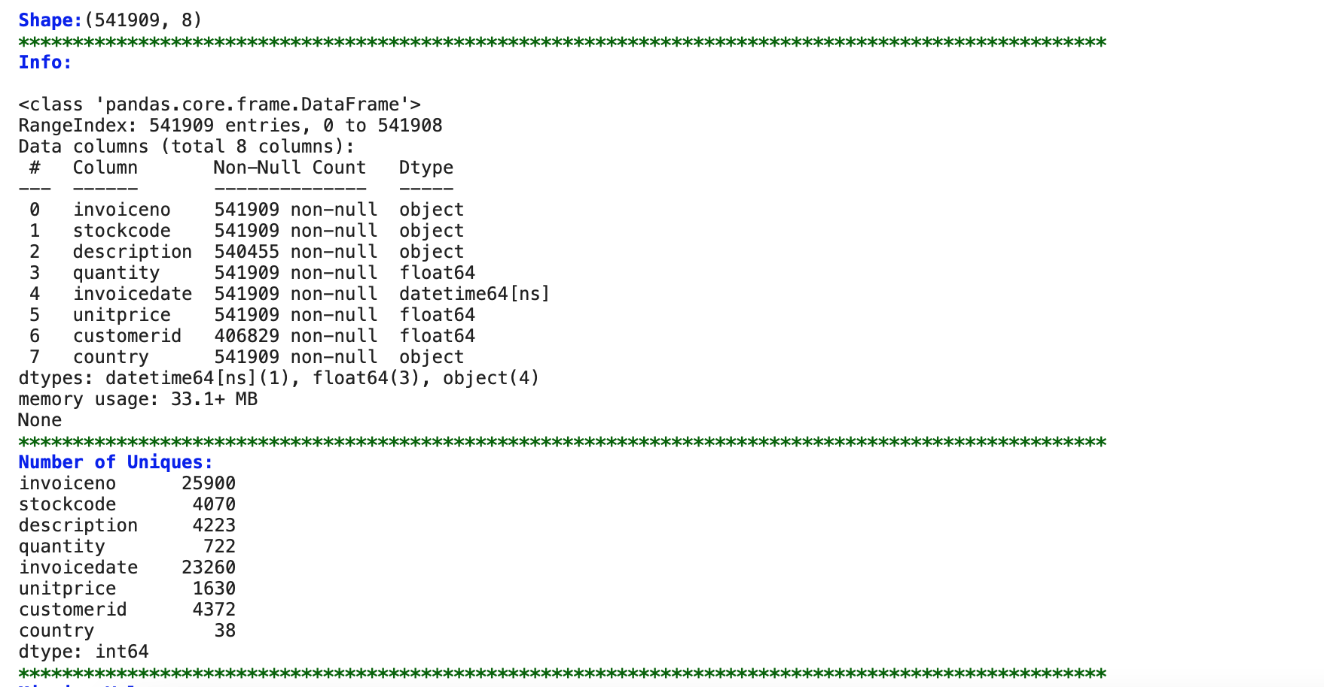
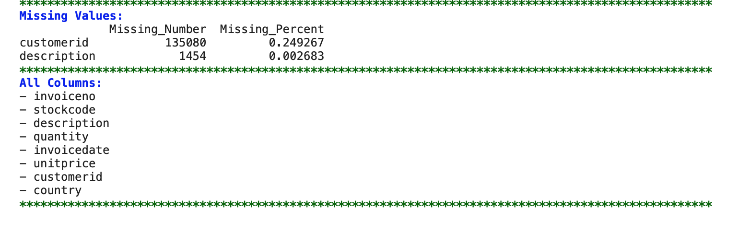
STEP 1

Slide 10
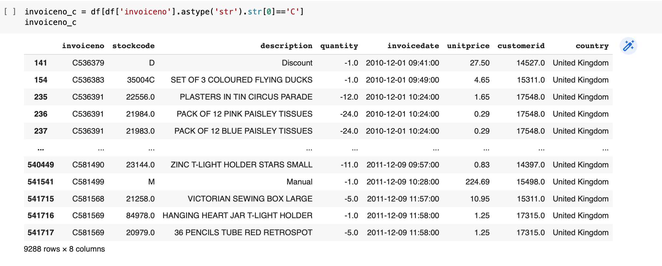
Invoice number starts with the letter "C"
It means the order was cancelled.
STEP 1

Slide 11
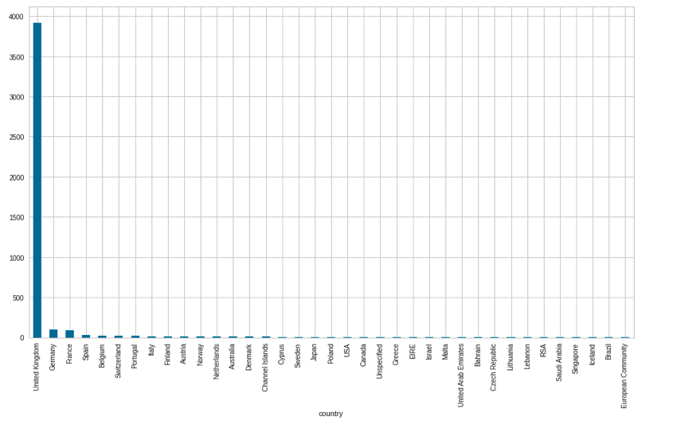
Number of Customer per Country
STEP 1

Slide 12
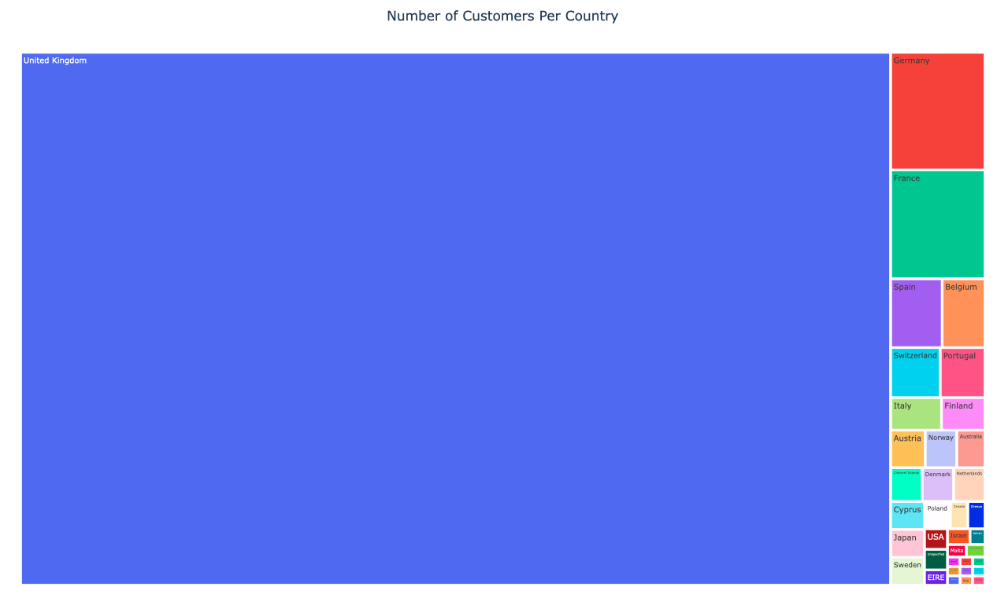

Slide 13
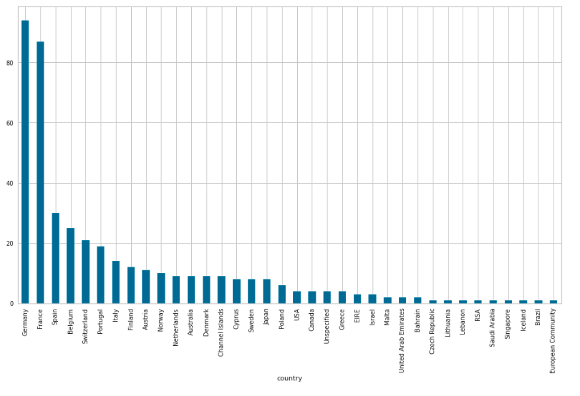
Number of Customer per Country without UK
STEP 1

Slide 14
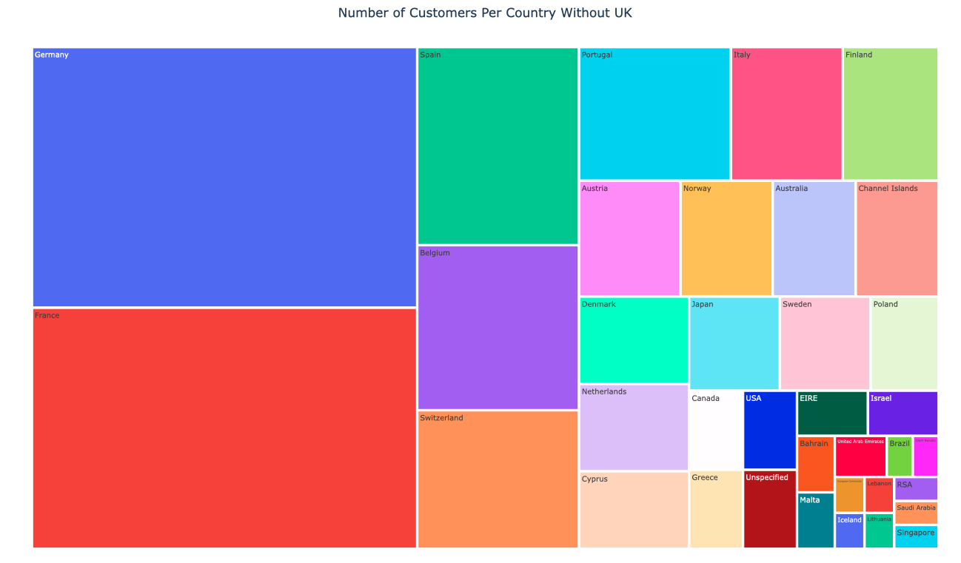

Slide 15
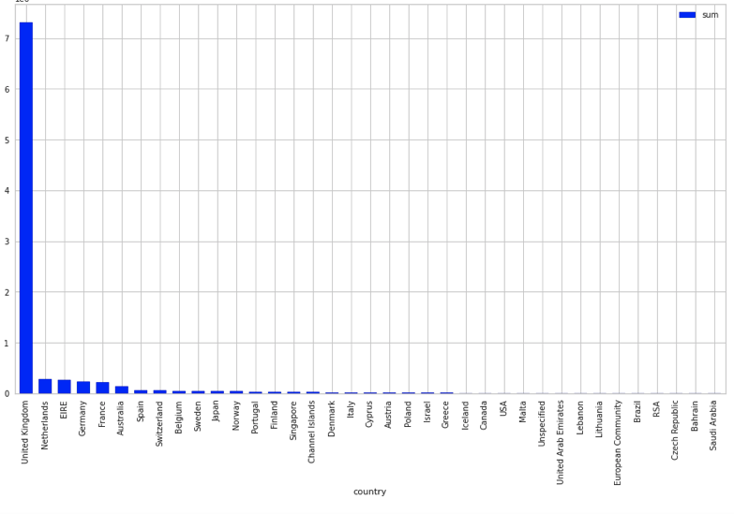
Total Cost per Country
STEP 1

Slide 16
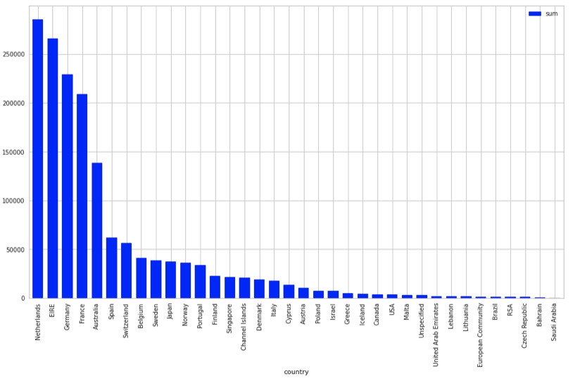
Total Prices Per Country Without UK
STEP 1

Slide 17
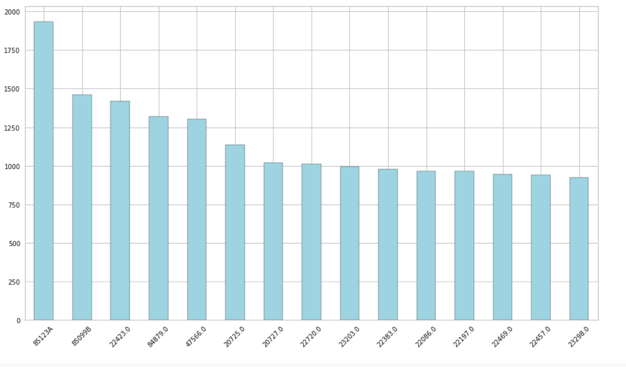
Top 15 most owned products in UK
STEP 1

Slide 18
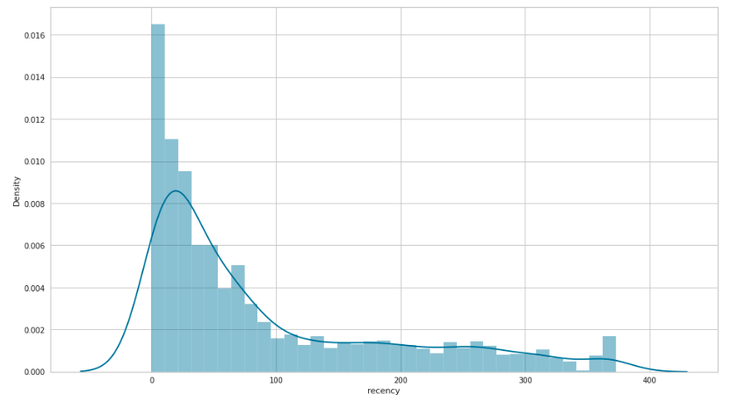
STEP 2
RECENCY

Slide 19
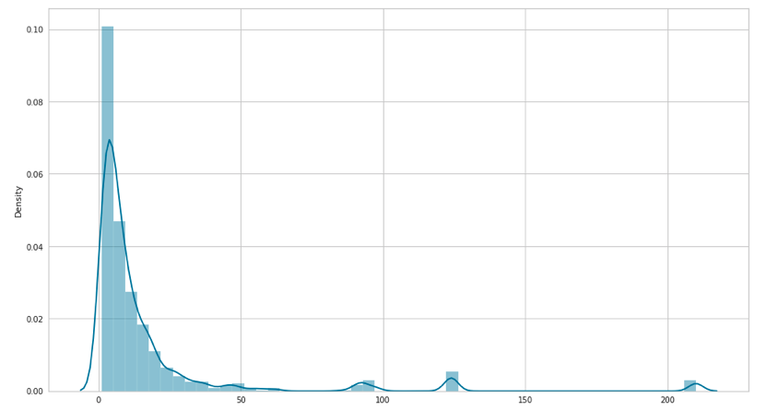
STEP 2
FREQUENCY

Slide 20
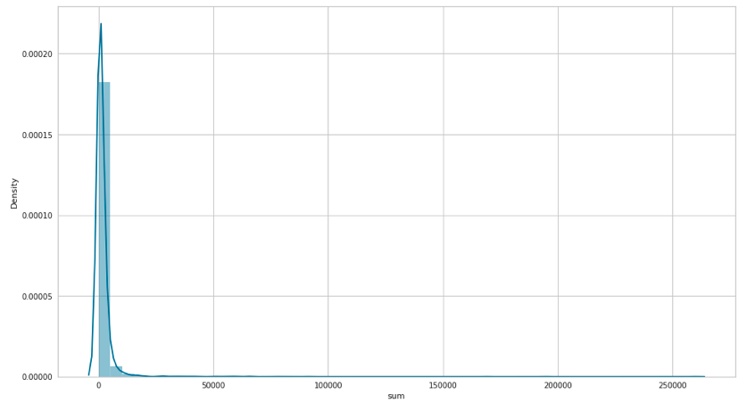
STEP 2
MONETARY

Slide 21
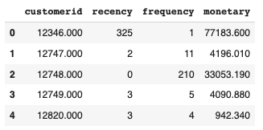
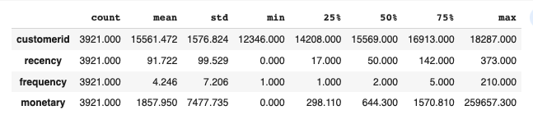
STEP 2

Slide 22
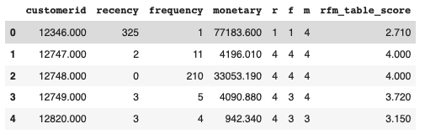
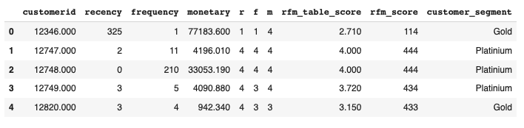
STEP 2
Customer Segmentation with RFM Scores

Slide 23
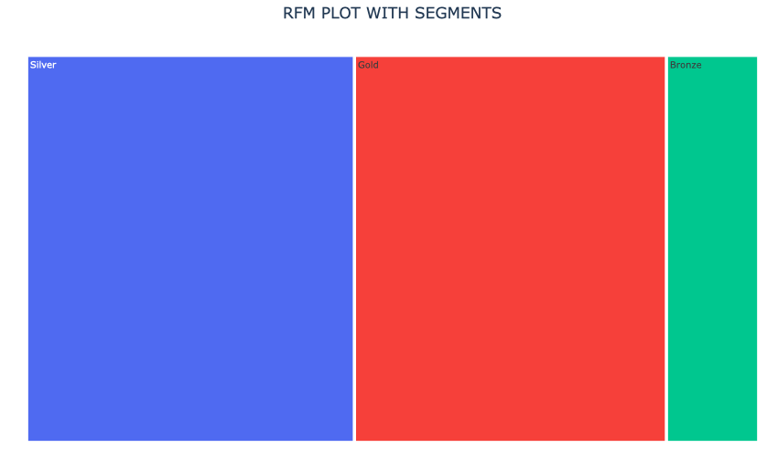
STEP 2
Total Customers for UK
349226
%34
%35
%31
47%
31%
22%
Customer Segmentation
Gold 108260
Silver 164136
Bronze 76830

Slide 24
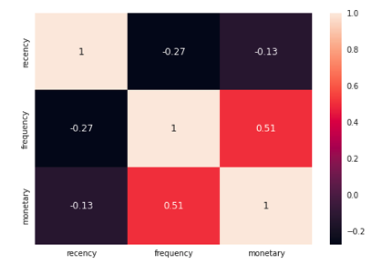
STEP 3

Slide 25
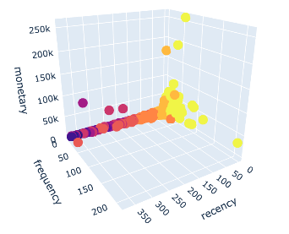
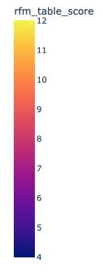
STEP 3

Slide 26
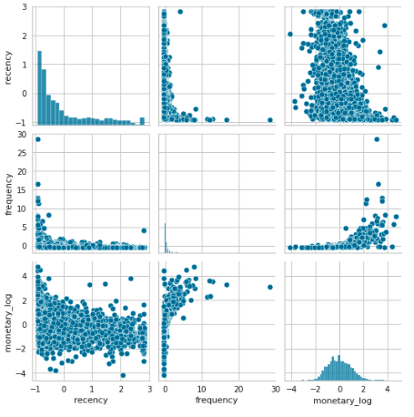
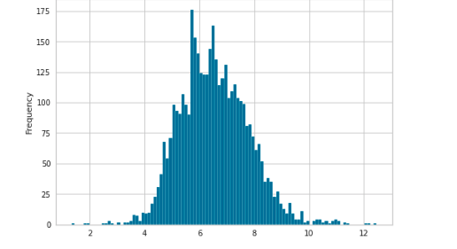
STEP 3
After log transform for frequency

Slide 27
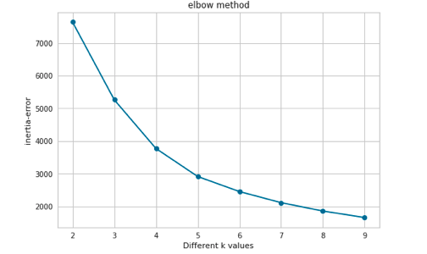
STEP 3

Slide 28
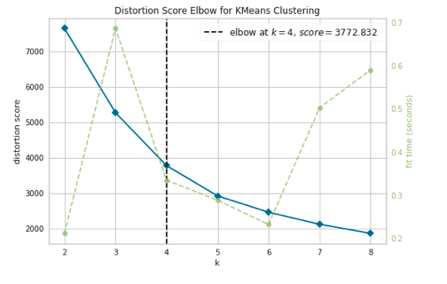
STEP 3

Slide 29
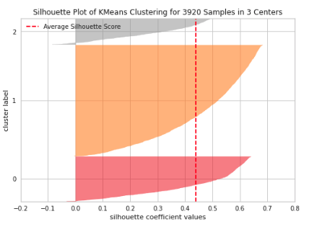
STEP 3

Slide 30
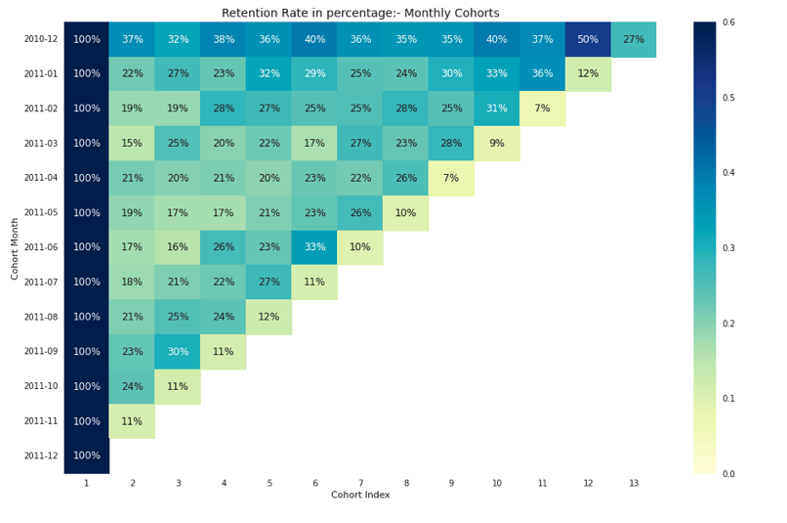
STEP 4

Slide 31
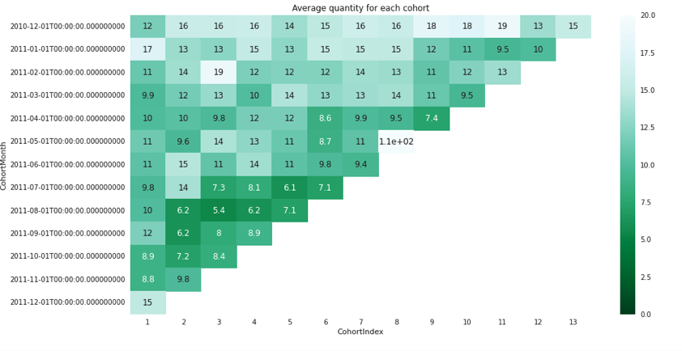
STEP 4

Slide 32
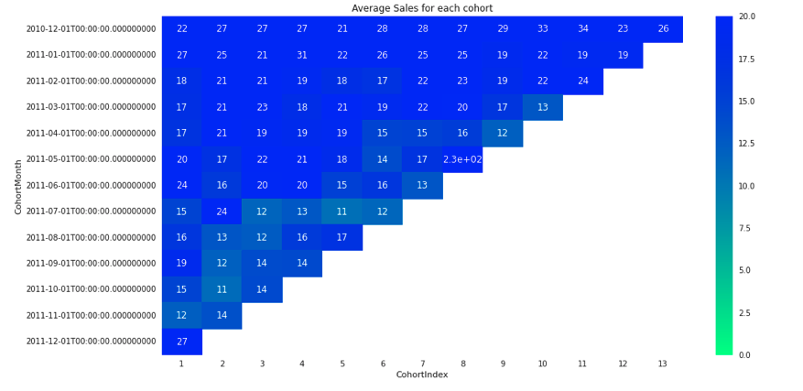
STEP 4

Slide 33
NOTEBOOK

Slide 34
FEEDBACKS

Slide 35
THANK YOU

